Slide 1
Functional Programming :l foo “Haskell”
Markos Vassilis, Mediterranean College, 2024 - 2025, Fall
Week 09

Slide 2
Functions, Functions, Functions…

Slide 3
Greater Than 10
It is well known that all positive integers greater than 10 are boring.
Write a function that filters a list of integers and keeps only non boring functions:
noBore :: [Int] -> [Int]
noBore :: [Int] -> [Int]
noBore ls = filter lt10 ls
where lt10 n = n <= 10 && n > 0
But, why waste our time and define lt10 ? Is there any chance we will use it elsewhere?

Slide 4
Anonymous Functions
In many cases, you just need a function for a particular occasion but you do not want to pollute the namespace by defining it globally.
This what where actually does.
However, why even give it a name?
This is what anonymous functions are for!
noBore :: [Int] -> [Int]
noBore ls = filter (\n -> n <= 10 && n > 0) ls
Syntax: \ <input> -> <body>
The -> (arrow) substitutes “=” in a typical function definition.
The \ is intended to look like a lambda (λ) just without the left short left (true story…).

Slide 5
Operator Sections
Things might be even shorter in some cases.
Consider this function:
aBitBore :: [Int] -> [Int]
aBitBore ls = filter (\n -> n <= 10) ls
Haskell offers a special syntax for the case of such simple functions where we just want to apply a single operator on some input:
aBitBore :: [Int] -> [Int]
aBitBore ls = filter (<=10) ls
Essentially, we abstract out the name of the input, since it does not really matter.
In general, this (?x) thing, where ? is any Haskell operator is called an Operator Section. So, it works with any other operator such as <, >, ==, etc.

Slide 6
More Abstraction
Reconsider this example:
aBitBore :: [Int] -> [Int]
aBitBore ls = filter (<=10) ls
Why do we need ls?
Actually, we do not, since we know (type declaration) that this function is applied onto a list of integers.
So, why even name it?
aBitBore :: [Int] -> [Int]
aBitBore = filter (<=10)
This makes our code even more succinct (and somewhat cryptic for non–Haskell people…)

Slide 7
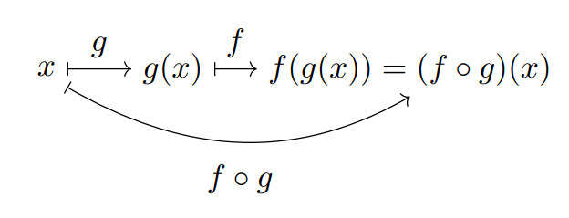
Function Composition
We have informally talked about function composition in the past.
A brief maths interlude:

Slide 8
Function Composition
Since (almost) everything is a function in Haskell, we can think of them as “objects” on which we can operate.
For instance, assume we want to check whether the length of a list is even or not. How would you implement this in Haskell?
evenLn :: [a] -> Bool
evenLn ls = even (length ls)
The above is a typical example of function composition:
We first compute the output of length on ls, and then;
We then compute the output of even on the previous output.
Such function “chaining” cases are typical for function composition:
evenLn :: [a] -> Bool
evenLn = even . length

Slide 9
Your Turn
Define a function comp that implements function composition in the same way that . does.
The function signature should be as follows:
comp :: (b -> c) -> (a -> b) -> (a -> c)
Take some time to think of it…

Slide 10
Currying

Slide 11

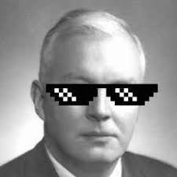
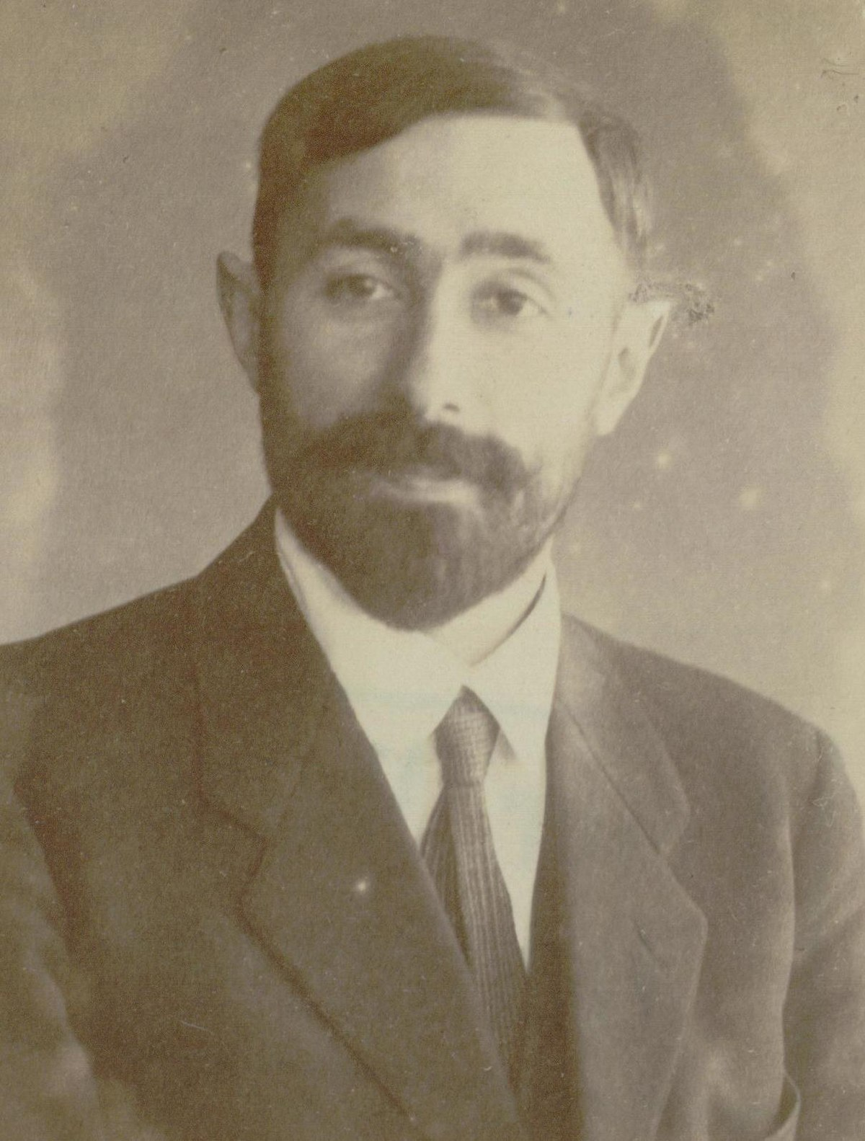
[Cringe Alert!] Curry
Steph Curry
Haskell Curry
No Curry

Slide 12
Currying
Consider the following function:
foo x y = x + y
What would be its signature? (there are multiple correct answers).
Assuming that everything is an integers:
foo :: Int -> Int -> Int
Why is that? (Recall freely from previous lectures).
Essentially, this is an instance of what we call “Currying”.
On a side–note, currying was not first invented by Curry (neither Steph, no Haskell), but by Moses Schoenfinkel (the third guy on right in the previous slide).

Slide 13
Currying
But, what is currying, actually?
As we saw before, foo, while seeming accepting two arguments, actually accepts a single argument which is an integer and outputs a function taking as input an integer and returning another integer.
So, Int -> Int -> Int should be read as: Int -> (Int -> Int), but we typically omit the right-most parentheses in such cases.
This is the quintessence of currying: We can represent any function taking n arguments as a composition of many single–variable functions that return other functions!
This is really useful at a more formal level, since it allows proving stuff about (efficient) computability of programs

Slide 14
curry And uncurry
Haskell offers two nice functions regarding currying stuff and uncurrying stuff:
curry f x y = f (x, y) → Typically, this makes a function f accept its two arguments as a single tuple, like a “two arguments” function.
uncurry f (x, y) = f x y → The opposite of the previous one.
For instance:
uncurry (+) (4, 7) → 5
Why don’t we have curry uncurry versions for more than two arguments?
Stay tuned…

Slide 15
Partial Application
How can currying help us - besides making function declarations seem bogus?
This is roughly what happens here:
bar :: [Integer] -> [Integer]
bar = filter (>3)
We have defined this one through composition, omitting any arguments.
Since we omit one argument from filter, what does filter return?
filter (>3) actually returns a function that waits for a list and outputs another list.
Exactly what bar is!

Slide 16
Folds

Slide 17
What Do You Observe?
What do the following functions share in common?
sum' :: [Integer] -> Integer
sum' [] = 0
sum' (x:xs) = x + sum' xs
product' :: [Integer] -> Integer
product' [] = 1
product' (x:xs) = x * product' xs
length' :: [a] -> Int
length' [] = 0
length' (_:xs) = 1 + length' xs

Slide 18
Even More Abstraction
In all cases above, each function:
Has a base case of how to handle an empty list.
Then applies the same operation to each element of the list.
Consider this list: x == [2, 5, 1, 3]:
Remove syntactic sugar: x == 2:(5:(1:(3:[])))
Then, in order to compute the sum of its elements:
Substitute [] with 0
Substitute : with + and leave its elements as they are.
Voilà!

Slide 19
Even More Abstraction
Consider again x == [2, 5, 1, 3]:
Remove syntactic sugar: x == 2:(5:(1:(3:[])))
Then, in order to compute the product of its elements:
Substitute [] with 1
Substitute : with * and leave its elements as they are.
Voilà!
Consider again x == [2, 5, 1, 3]:
Remove syntactic sugar: x == 2:(5:(1:(3:[])))
Then, in order to compute the product of its elements:
Substitute [] with 0
Substitute : with + and each element with 1.
Voilà!

Slide 20
Even More Abstraction
In all cases above we what we actually do is:
substitute [] by some base value;
substitute the colon with the operation we want to perform on each element.
So, assuming the base value is a piece of data and the operation is a function (of “two arguments”), the pattern above looks something like this:
Get a list, e.g., x == [5, 2, 7, 4].
Remove syntactic sugar: x == 5:(2:(7:(4:[])))
[] → base, : → f (in prefix notation).
So: x == f 5 (f 2 (f 7 (f 4 base))).
This is called folding.

Slide 21
Your Turn!
Implement a (higher order) function that actually implements folding.
The function’s signature should be:
fold :: b -> (a -> b -> b) -> [a] -> b
That is, fold gets as parameters:
something of type b;
a function which gets something of type a and something of type b, returning an output of type b, and;
a list of elements of type a;
and returns something of type b (the same as the base case).

Slide 22
Our fold
fold :: b -> (a -> b -> b) -> [a] -> b
fold base f [] = base
fold z f (x:xs) = f x (fold z f xs)
Using the above, implement sum, length, and product.
One way of doing so:
sum'' = fold 0 (+)
product'' = fold 1 (*)
length'' = fold 0 (\_ s -> 1 + s)

Slide 23
foldr, foldl
Folding is implemented in Prelude in two ways:
foldr → right folding, as in our case, just with parameters passed in a different order (function, base value, list)
foldl → left folding.
Prefer foldl’ from Data.List since it is more efficient!

Slide 24
Fun Time!

Slide 25
Wholemeal Programming
Have some fun with the following lab from UPENN:
https://www.cis.upenn.edu/~cis1940/spring13/hw/04-higher-order.pdf
In case you get stuck, seek for help at: solutions/hof.hs.

Slide 26
Graded Lab
Take a tour to this semester’s next graded lab, as found in:
labs/5CM524 Lab 4_v1_2.docx
Take care to follow all instructions carefully and do not forget to take screenshots of your in-class work!

Slide 27

Any Questions
Don’t forget to fill in the questionnaire shown right!
Office hours: Tuesday: 09:00 —10:00, Glyfada, PC Lab Wednesday: 15:00 — 17:00, Pellinis, 203
https://forms.gle/YU1mjxjBjBf8hyvH7

